Slide 1
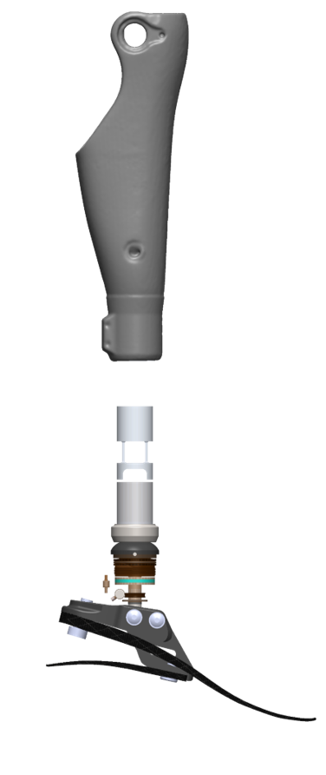
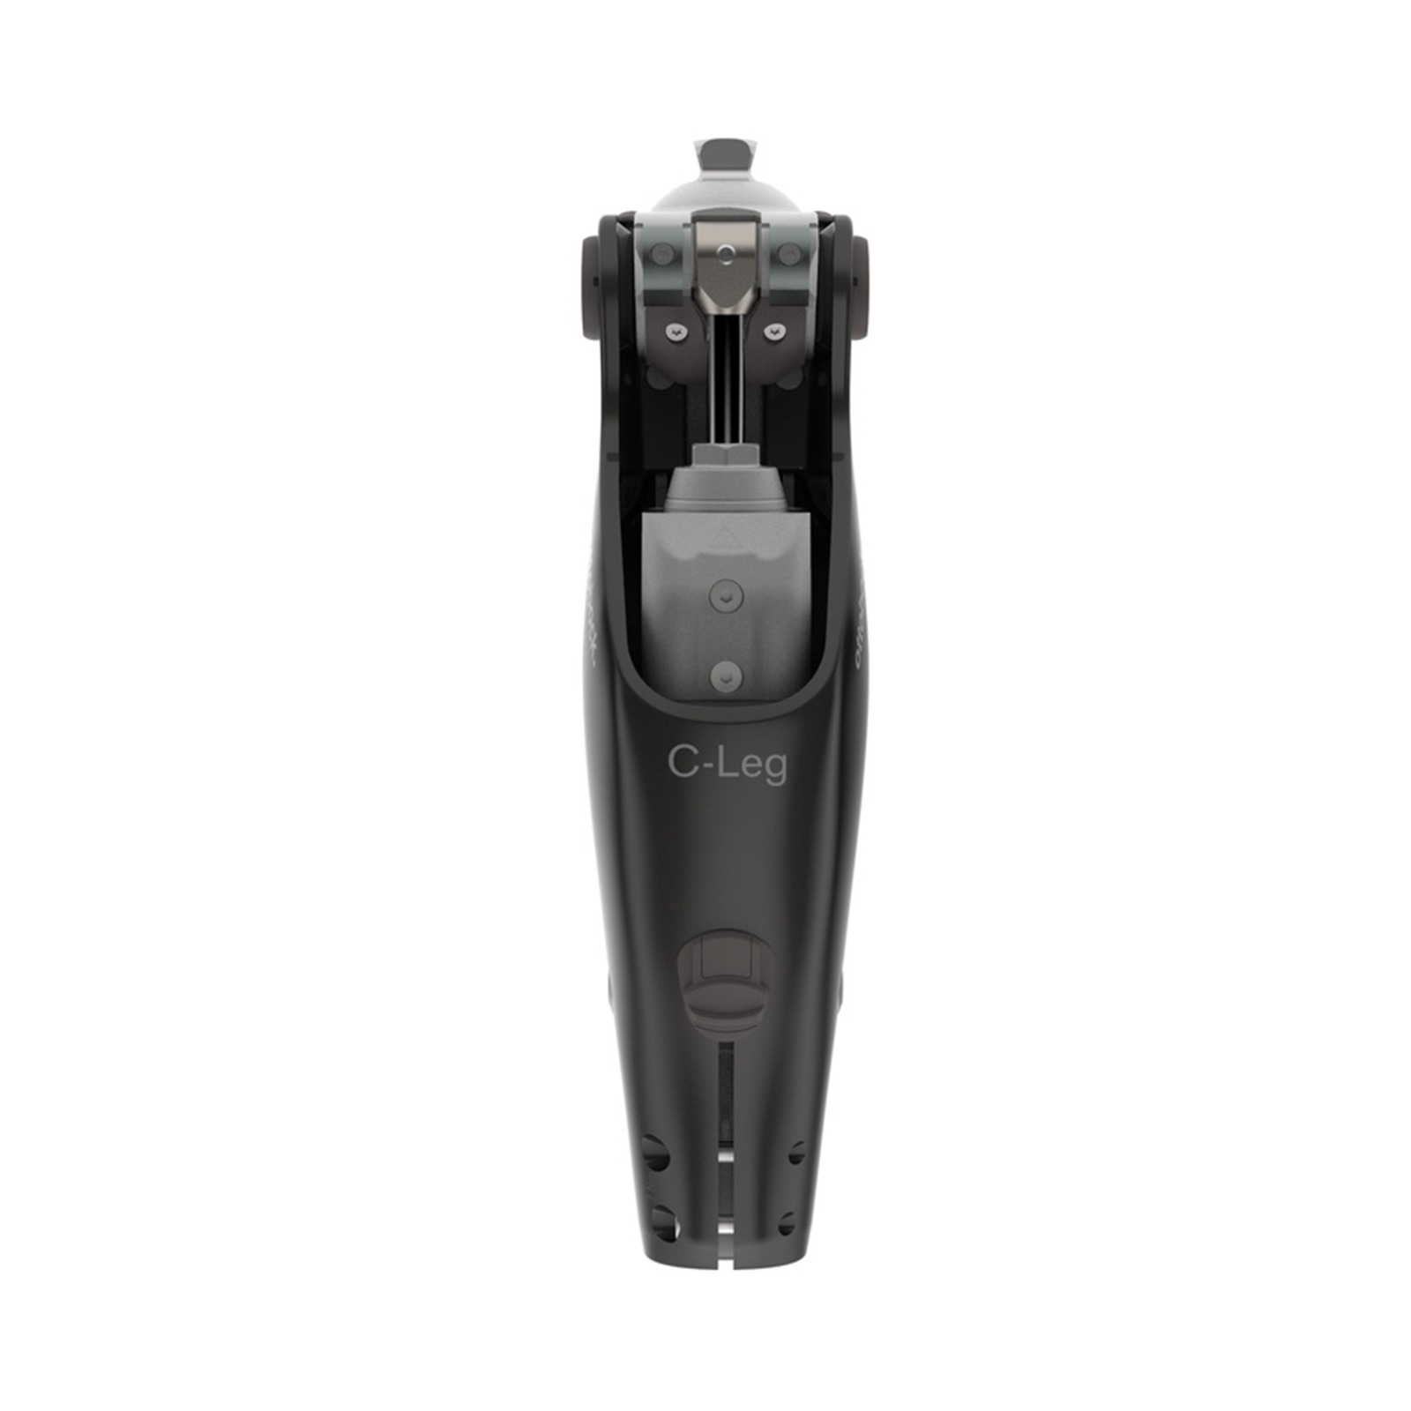
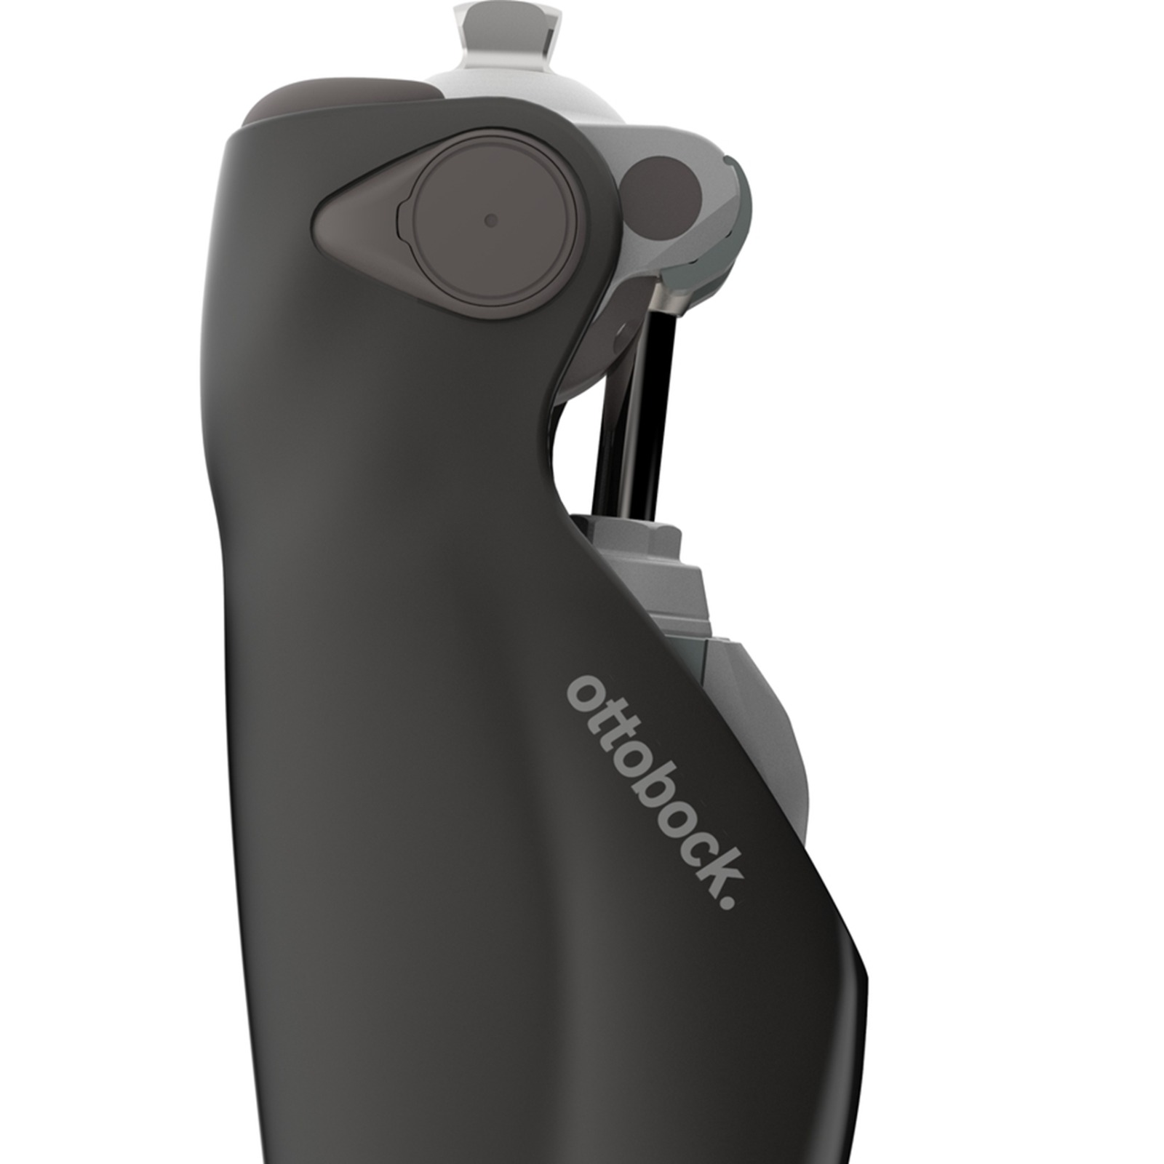


CONTROL SYSTEM DESIGN OF MICROPROCESSOR-CONTROLLED PROSTHETIC KNEE JOINT
Group K2
Ali Fuat Şahin
Can Uludoğan
Egemen İlikmen
Faysal Turkistani
Furkan Evci
Mehmet Furkan Doğan
Osman Berkin İnci
Fall 2022-2023 ME 407 Mechanical Engineering Design

Slide 2
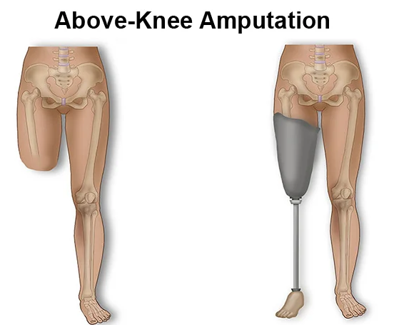
Problem Definition & Motivation
Definition
Designing a control system that provides adjustable damping according to the gait cycle phases.
Motivation
Allow transfemoral amputees to experience freedom and convenience in their daily activities.

Slide 3
Requirements & Performance Criteria
Requirements
Design the control system to work on the Ottobock C-leg Prosthetic Knee
Correctly identify gait cycle phases and adjust damping accordingly
Adjust damping to adapt to different users
Adjust damping to adapt to different walking speeds
Safety precaution mechanism for unexpected user behavior
Effective energy consumption
Performance Criteria
Rotate knee between 0 and 130 degrees
Walking speed up to 2 m/s
Provide standing, walking and running modes
Battery enough to walk 15000 steps with 1.6 m/s
Control system response delay time less than 5 ms
User interface and IoT
Control system cost less than $ 350
Control system less than 300 grams

Slide 4
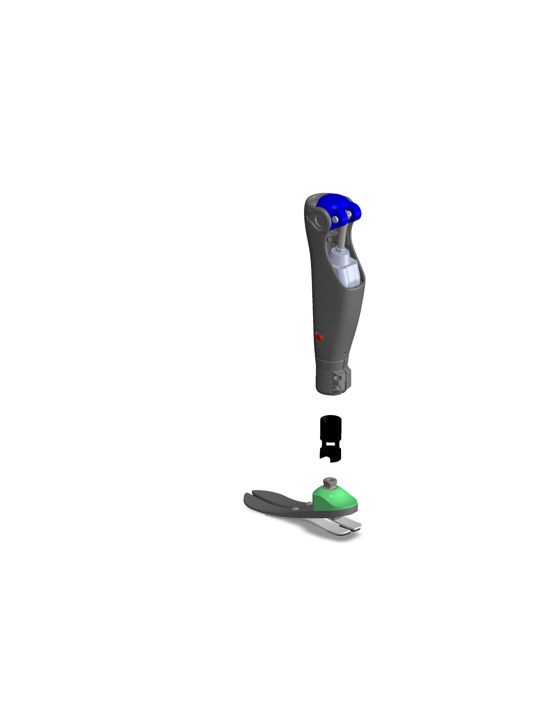
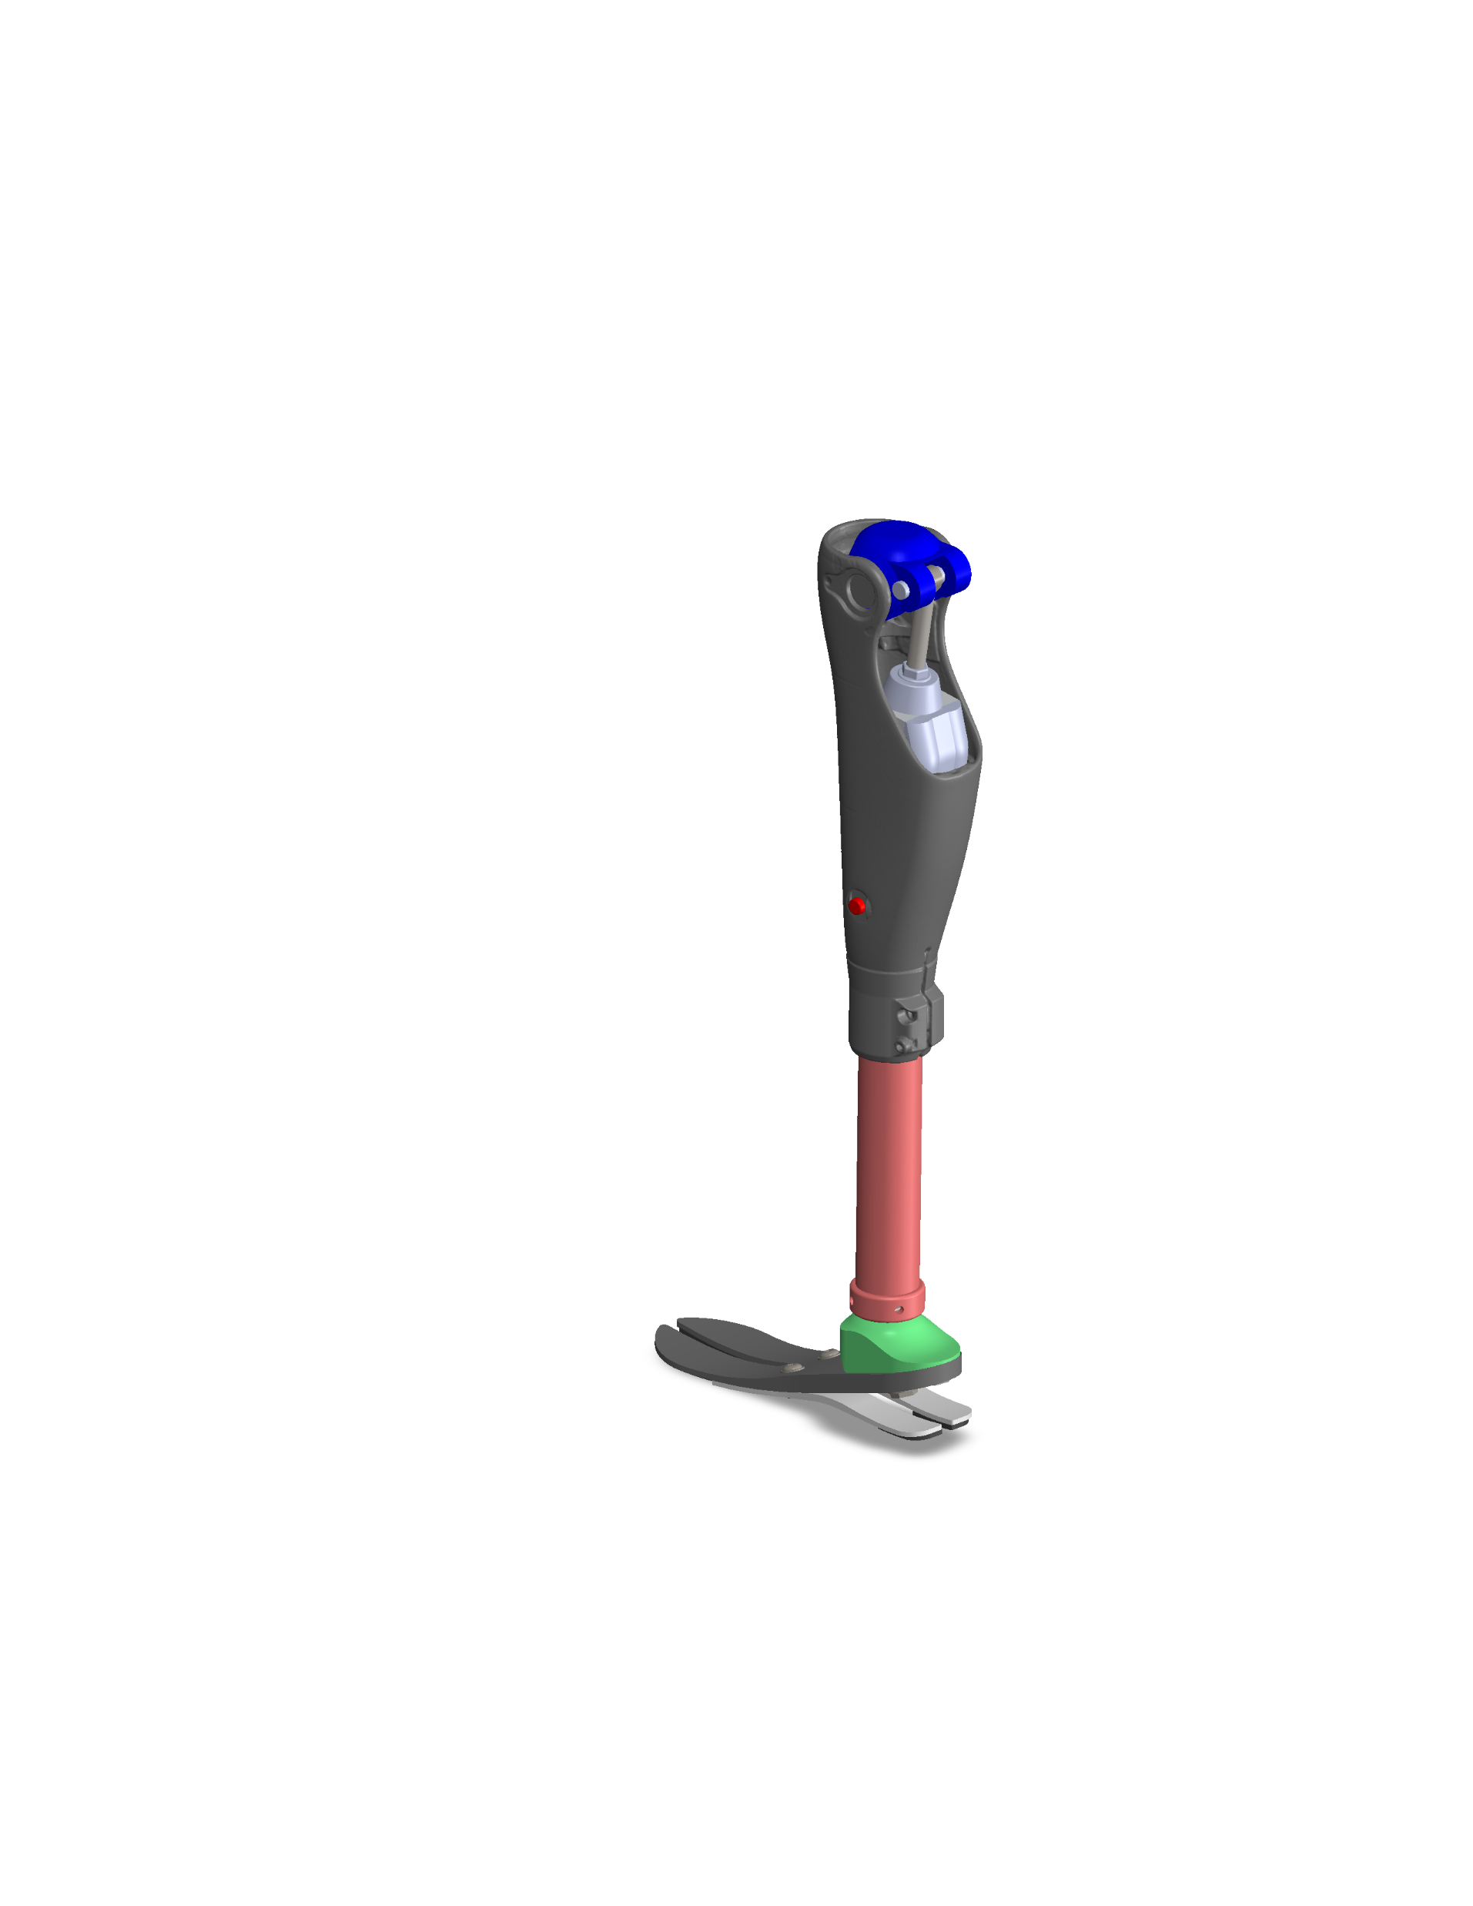
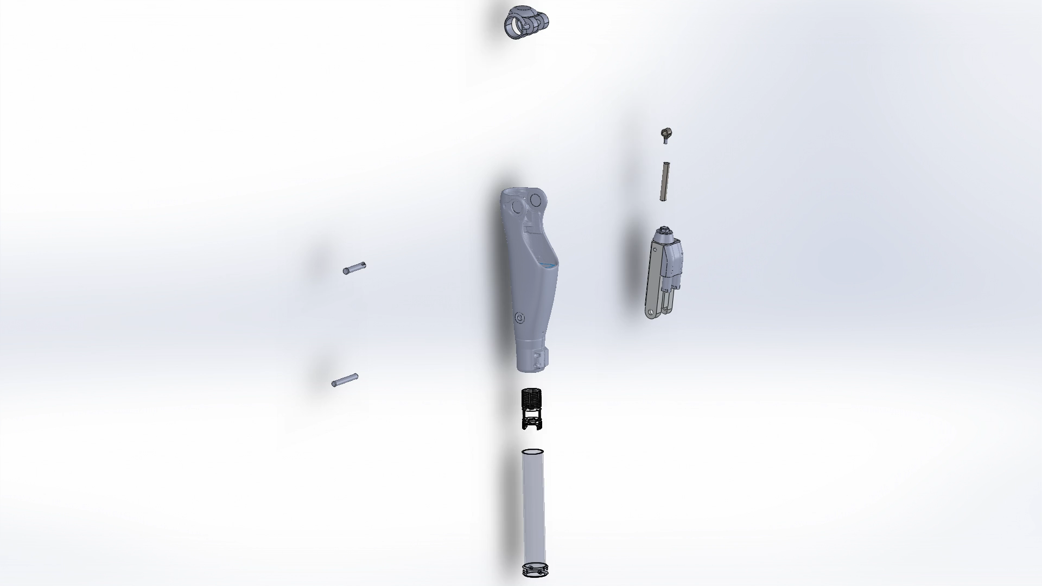
3D CAD Model ( Whole Assembly )

Slide 5
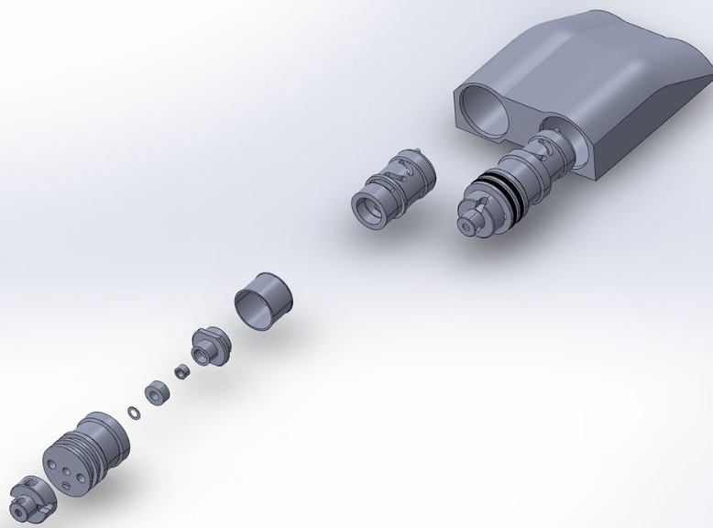
3D CAD Model ( Valve System)

Slide 6
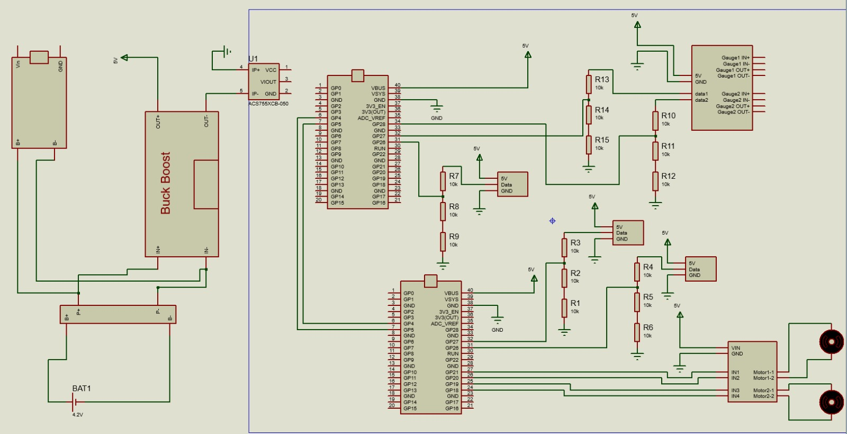
Circuit Working Principle

Slide 7
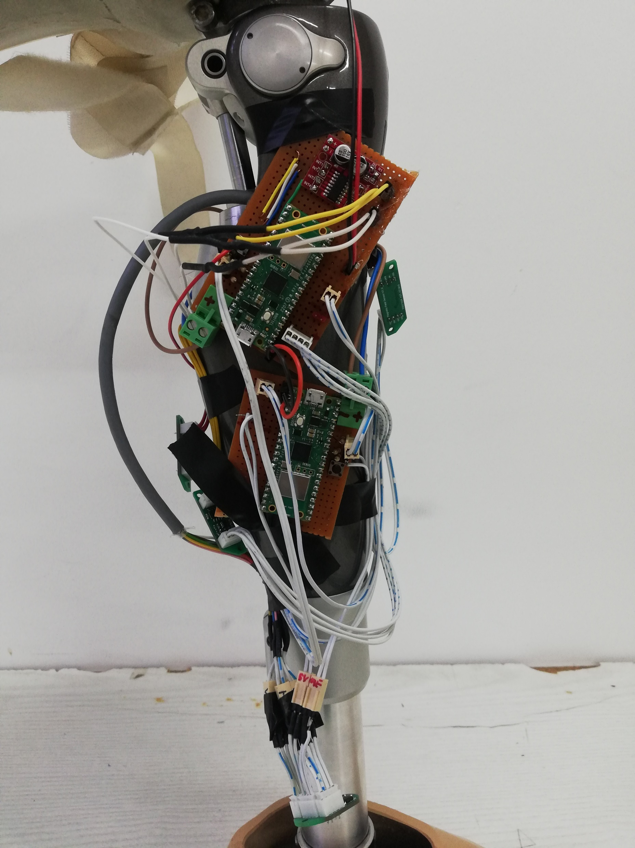
Final System Control Circuit

Slide 8
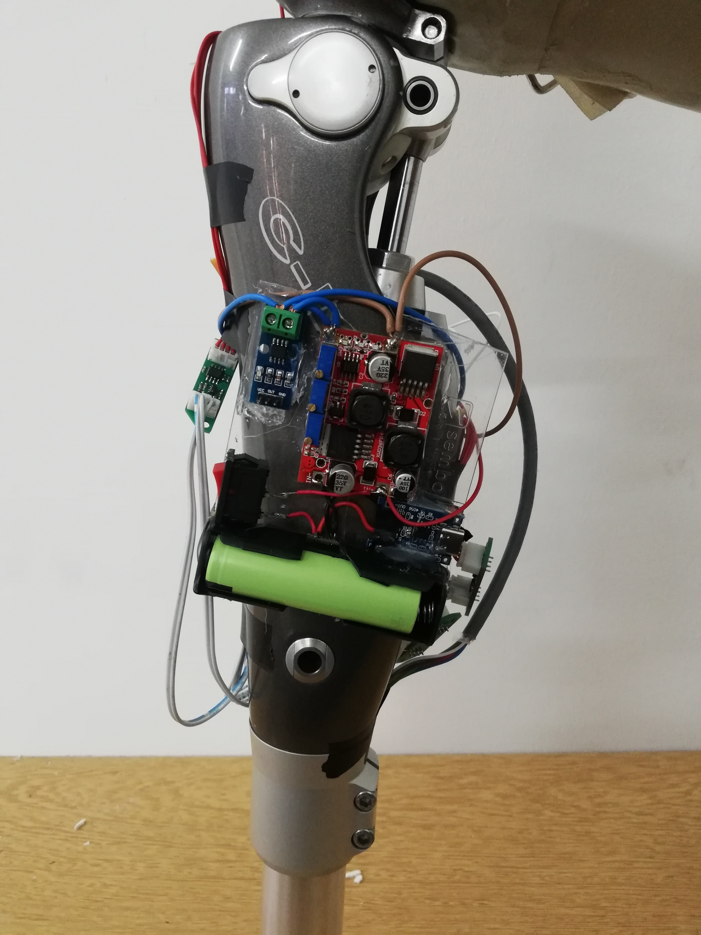
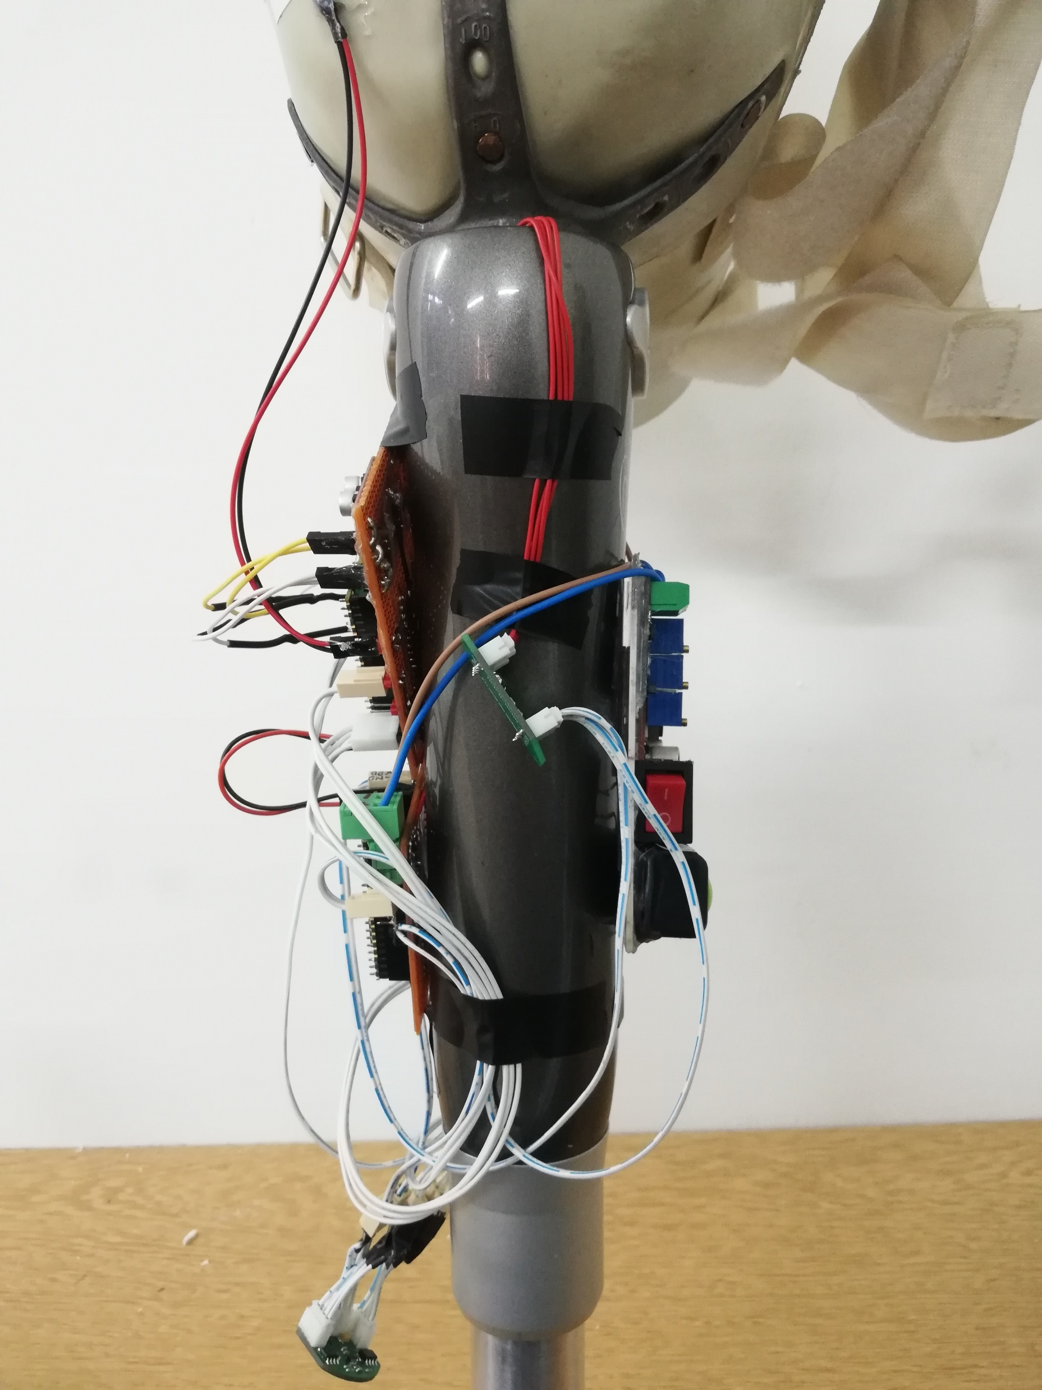

Slide 9
Energy Consumption
Cause of Energy Consumption | Number of Steps | Energy Consumption
Stand-by mode | 1 | 0.05 mWh
1 Valve Motor | 1 | 0.2 mWh
2 Valve Motors | 1 | 0.4 mWh
Total | 1 | 0.65 mWh
 | 15000 | 9750 mWh
Available Energy |  | 12000 mWh

Slide 10
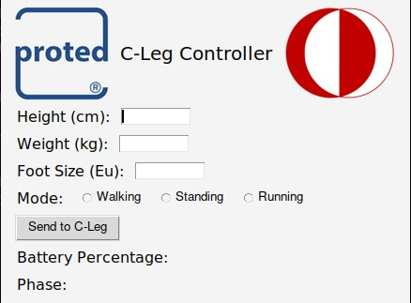
Communication with User

Slide 11
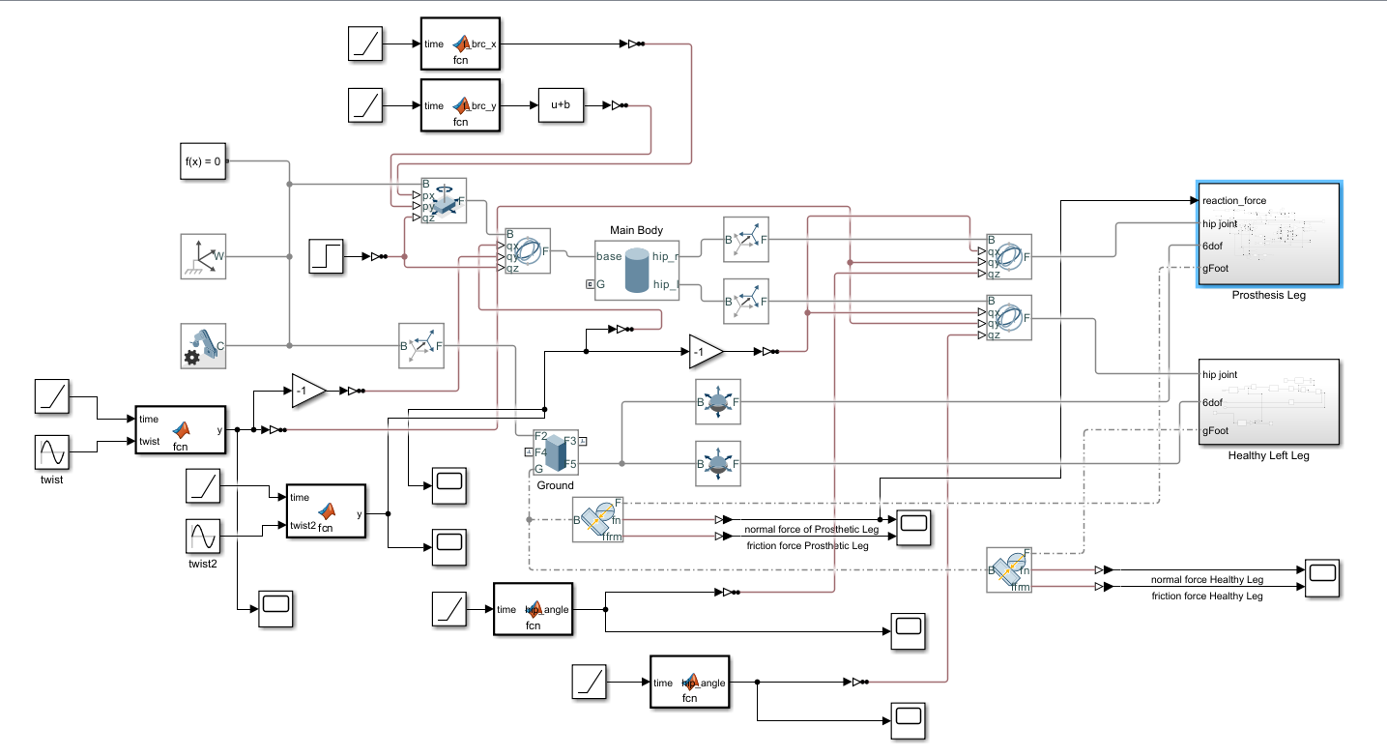
Simulink Walking Simulation

Slide 12
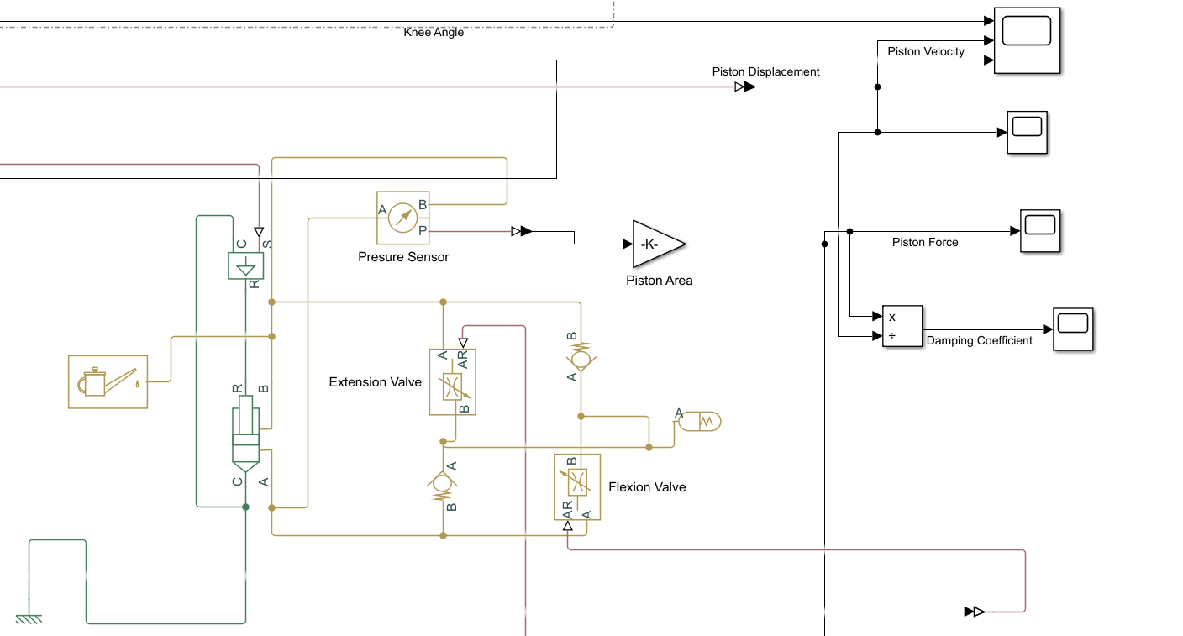
Hydraulics Simulation

Slide 13
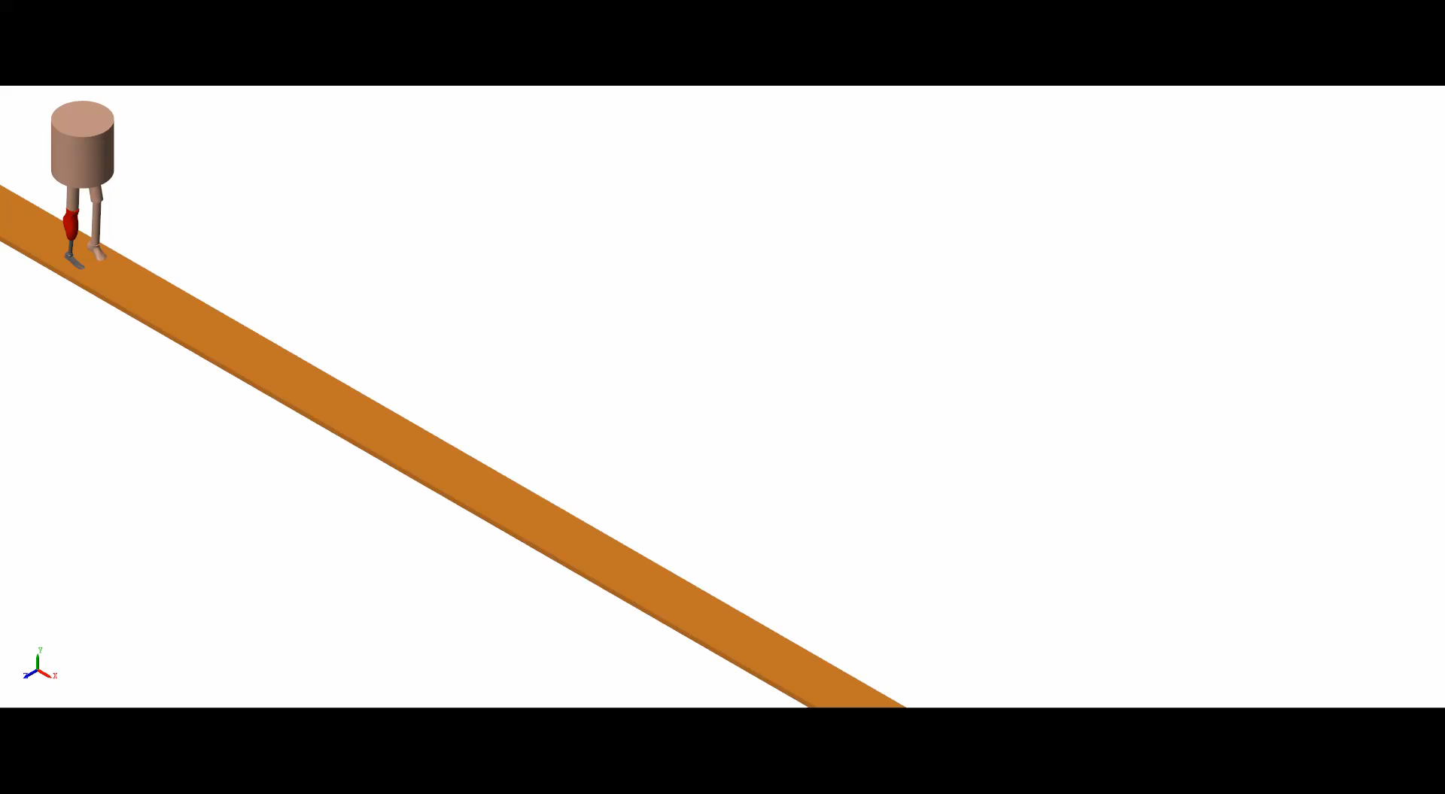

Slide 14
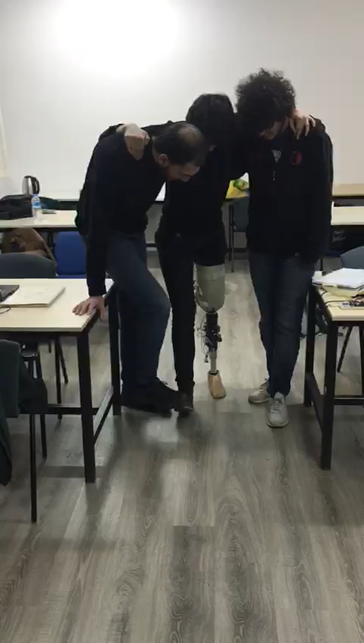

Slide 15
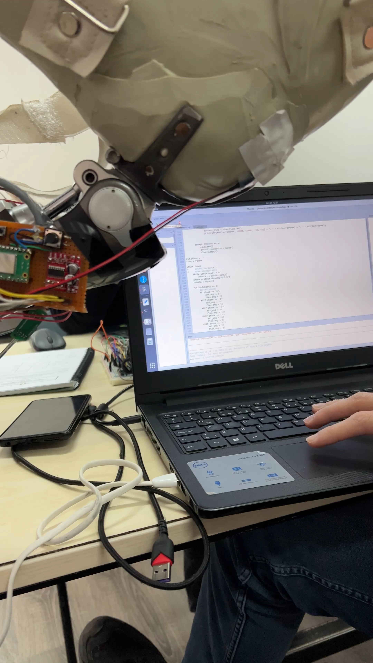
Safety Precaution

Slide 16

Modifications Between Mock-Up and Detailed Design

Slide 17
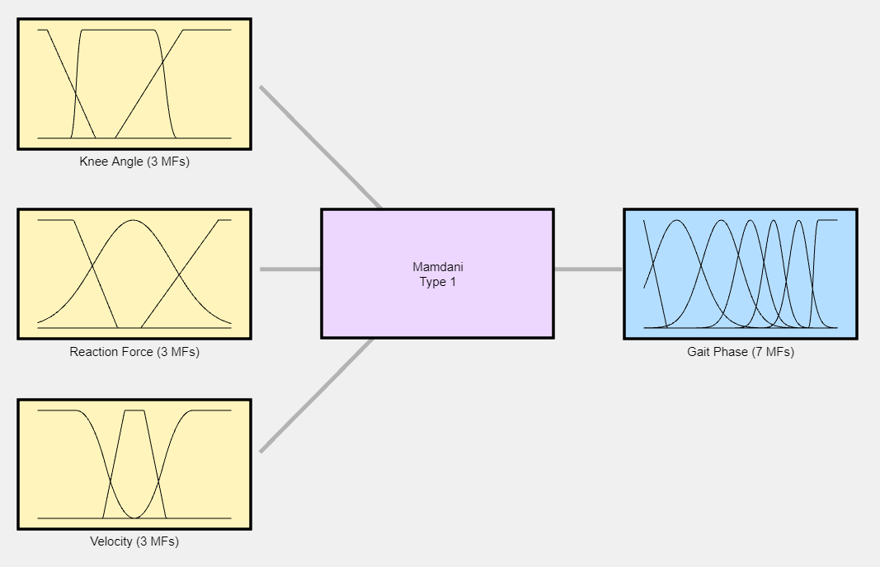
Fuzzy Logic Design

Slide 18
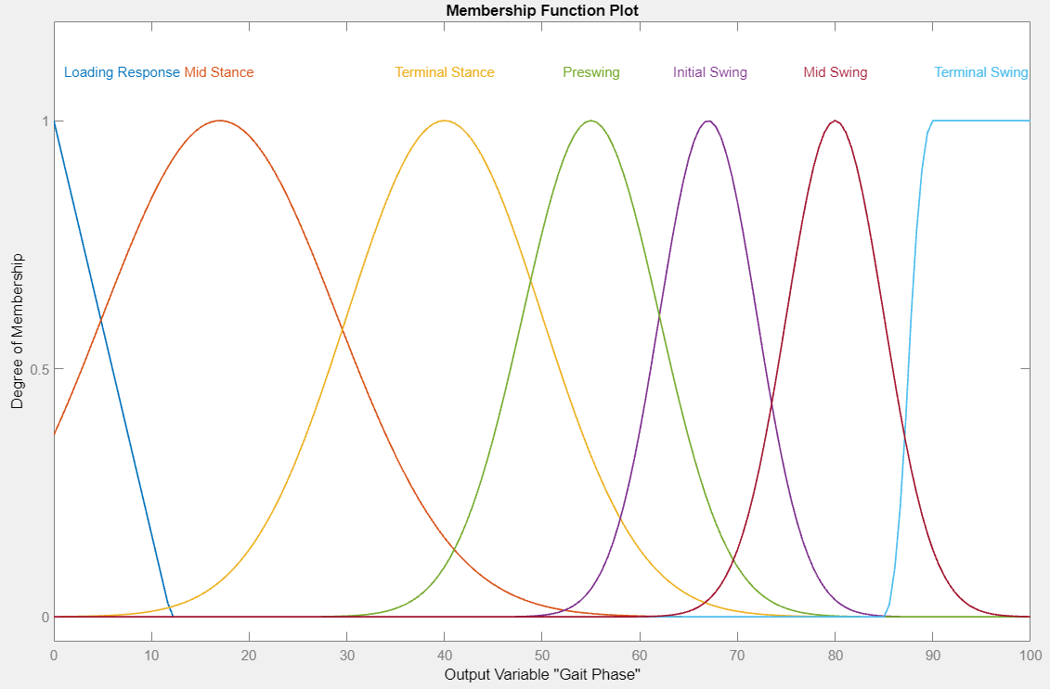
Membership Functions of Gait Phase

Slide 19
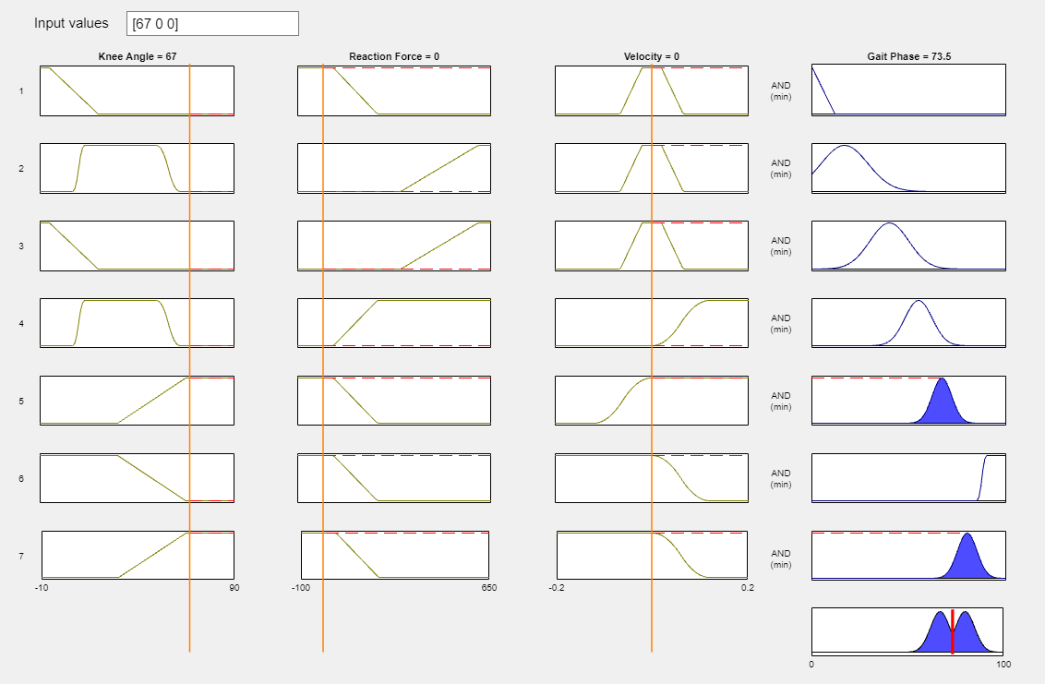

Slide 20
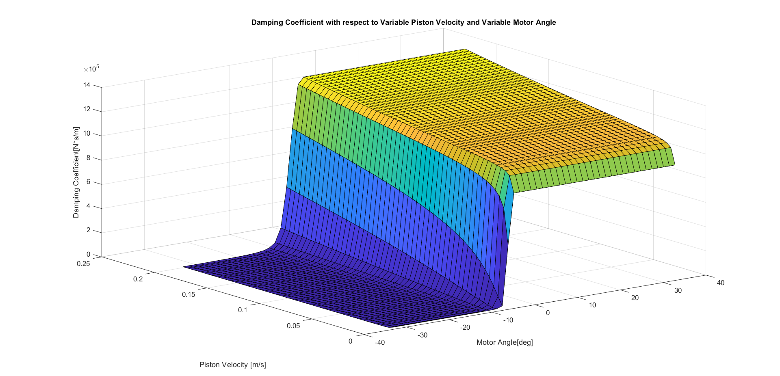

Slide 21
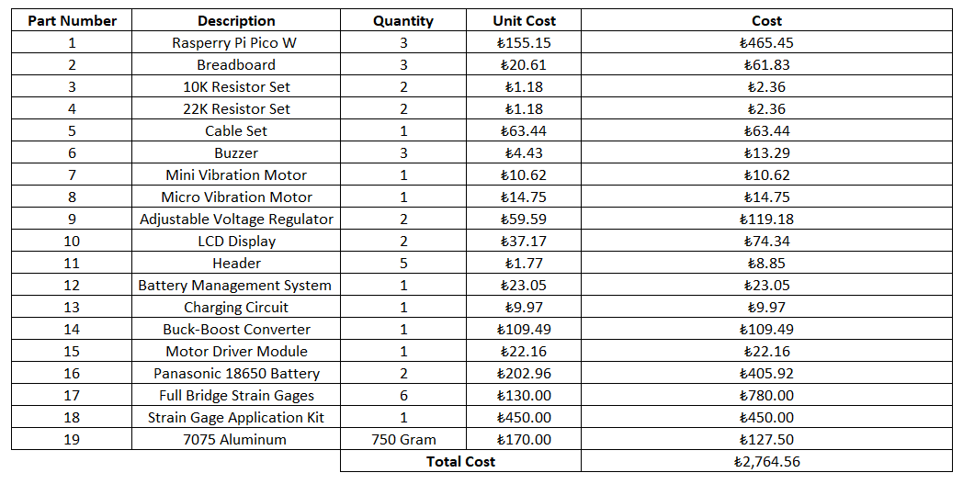
Parts Bought / Manufactured

Slide 22
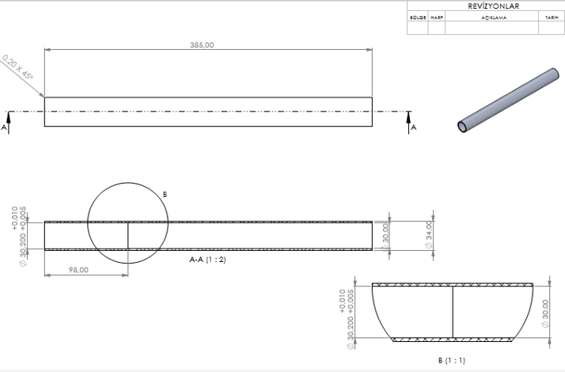
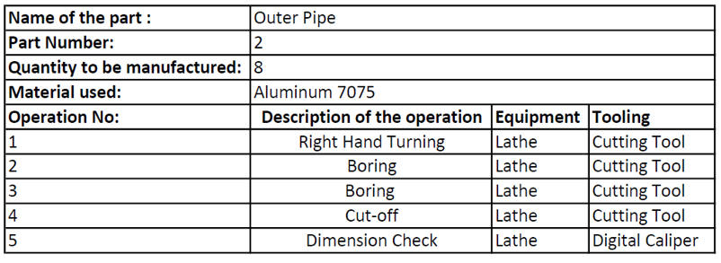
Pipe

Slide 23
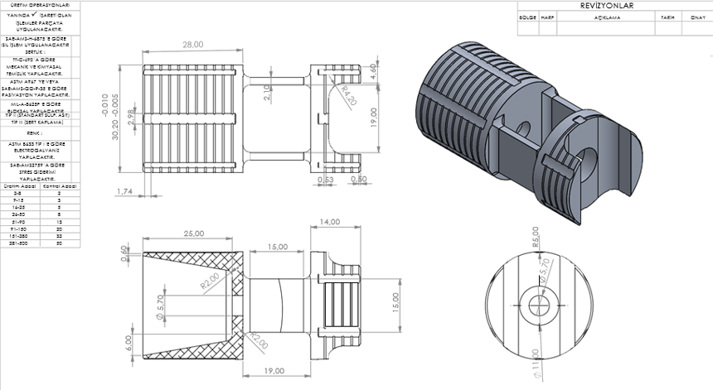
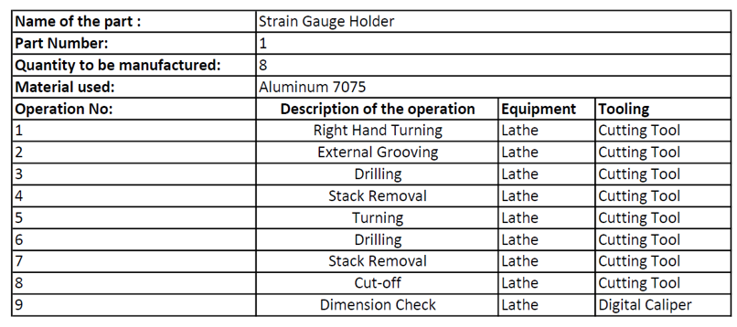
Strain Gage Holder

Slide 24
Experience Gained
Engineering analysis and simulations allowed prediction on how the design will perform under different conditions.
Identify problems early in the design process.
Testing provided view on the performance of the design in real world conditions and helped to validate and invalidate assumptions and analysis results.
Better understanding of design and limitations.
See potential areas for improvement

Slide 25
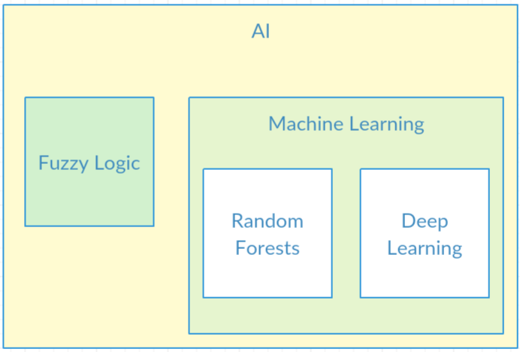
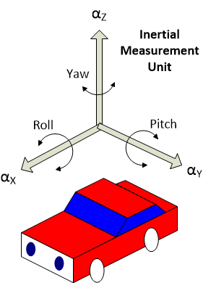
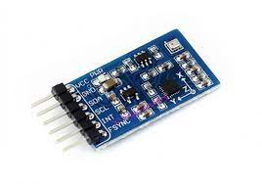

Machine Learning Implementation
Fuzzy logic optimization (tuning) can be done using machine learning to get more accurate and precise results.
Inertial Measurement Unit (IMU)
To increase the variety of inputs that can be fed into the control system IMUs can be used.

Slide 26
